Slide 1
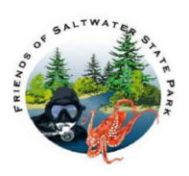
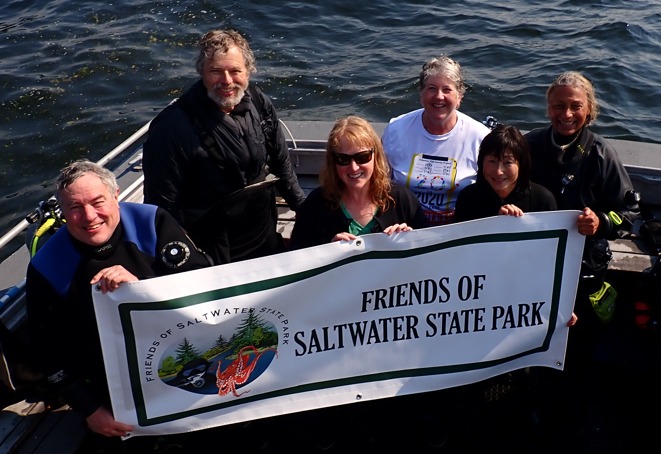
Saltwater underwater park surveys
Since 2019 Friends of Saltwater State Park have conducted seasonal surveys in 11 artificial reef locations in Saltwater Underwater Park. The goal of the surveys is to establish baseline data of marine life found in the park artificial habitats and to support a healthy and diverse marine ecosystem.
Here is one of several survey teams
after a day of surveys.
This presentation is some of the data
we consolidated from 2019 thru 2021.
We suggest encouraging bull kelp
forest in exchange for tire reef removal.

Slide 2
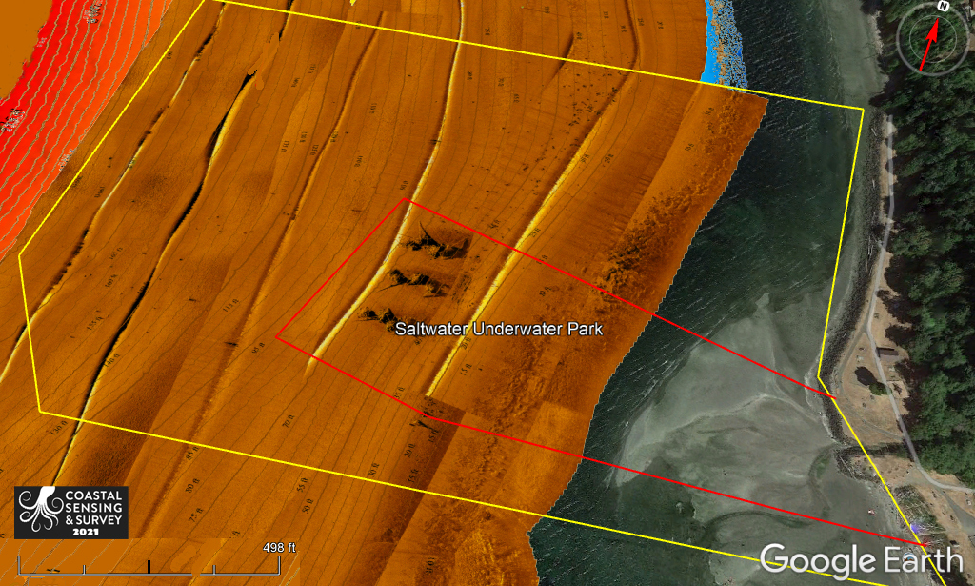
Underwater park sonar

Slide 3
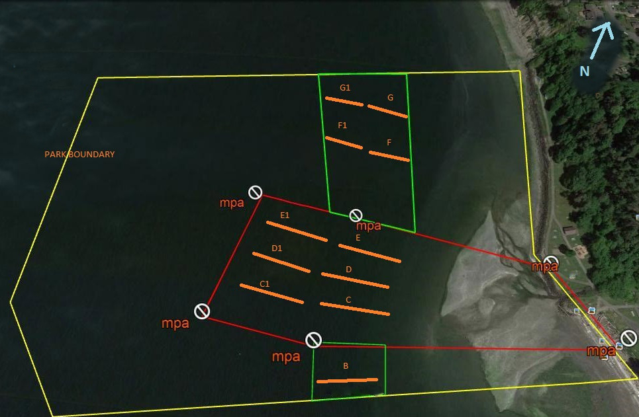
Underwater park 11 survey transects
Tires
3 Boulder Reefs
Cobble
Barge Ruins
Cobble
Pyramid

Slide 4
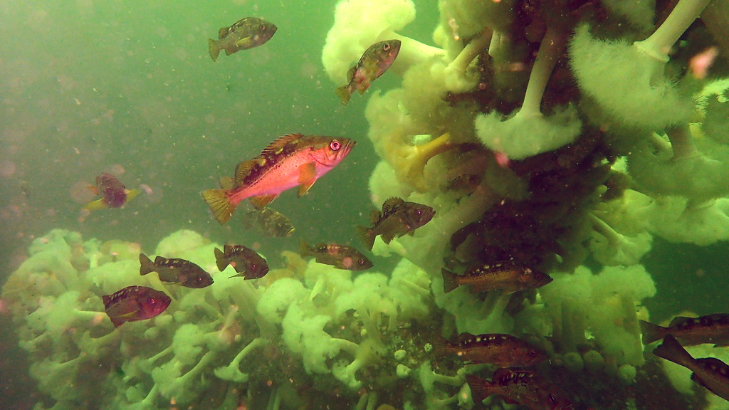
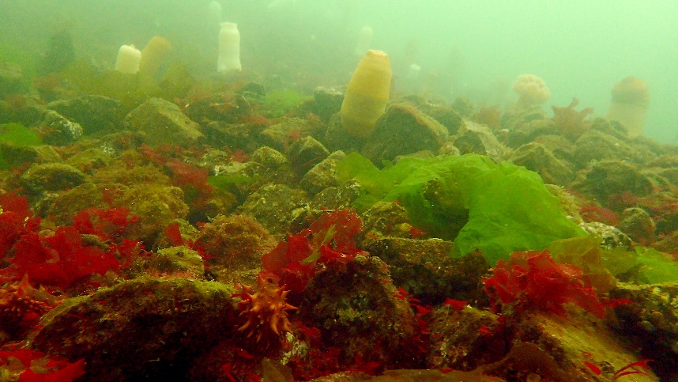
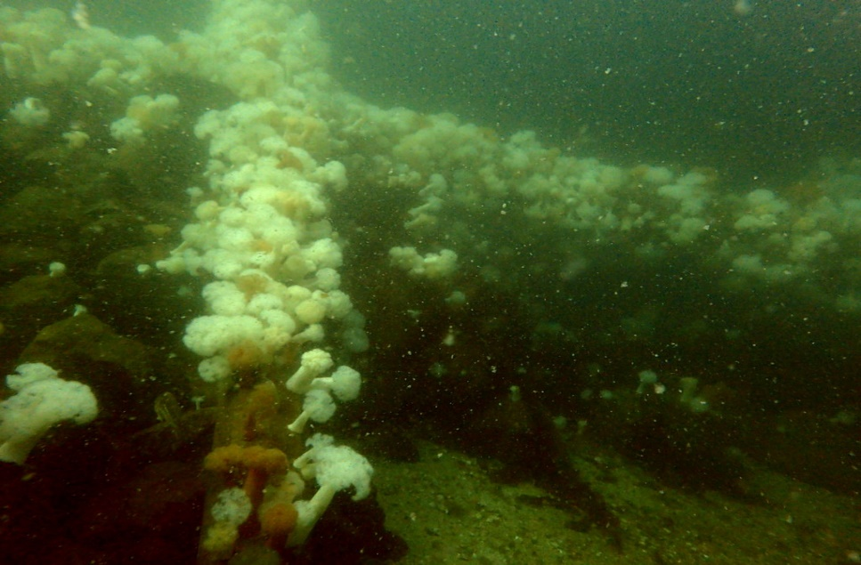
Successful sustainable artificial habitat
Boulder with concrete column reefs
Cobble reefs

Slide 5
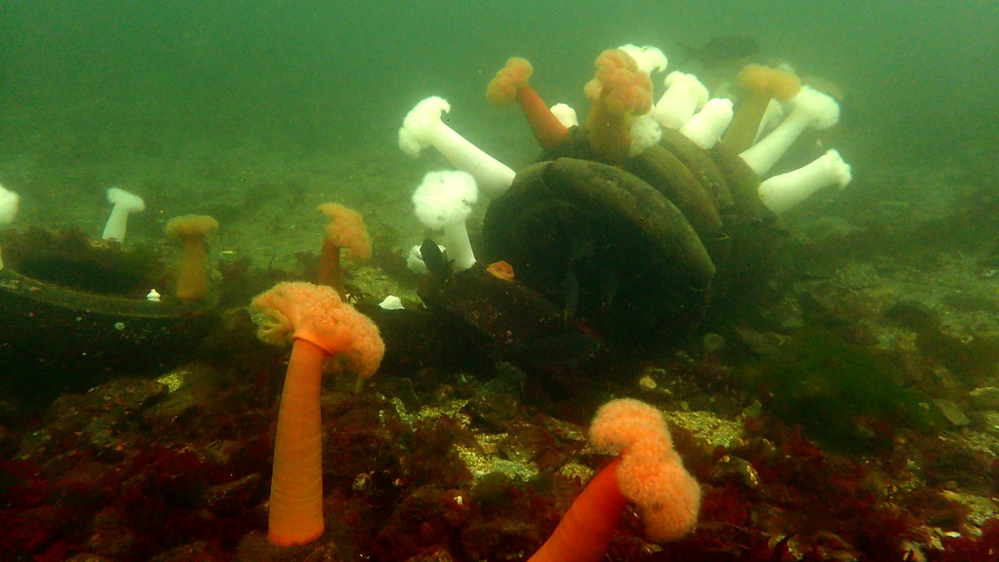
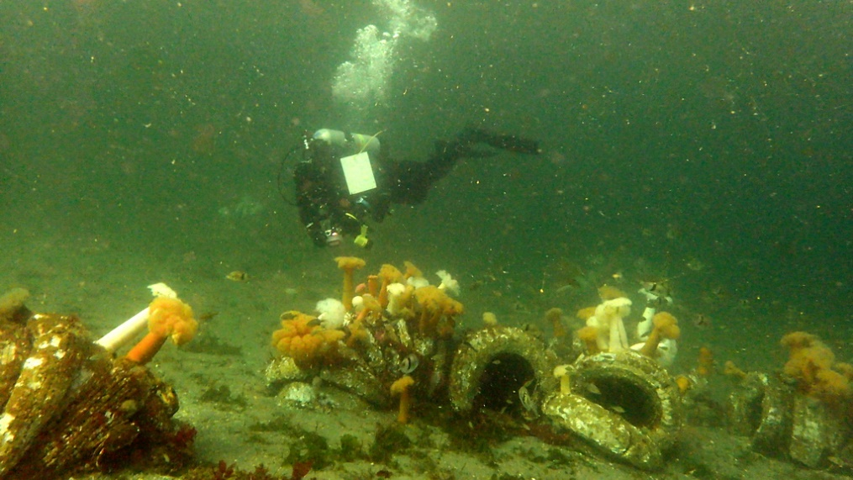
Tire reefs are poor habitat
The tires release toxins that are
poisonous to the food chain up
to the salmon and to the orcas.
Let‘s salvage the marine life.
Remove the tires.
Restore healthy kelp beds.
Restore marine life.

Slide 6
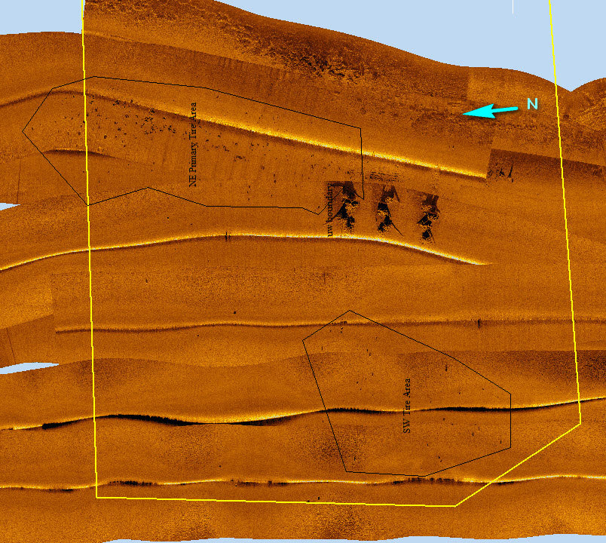
Tire reefs
All the little black dots are tire bundles ranging from 5 to 9 tires. There are at least 250 tire reefs consisting of over 3,000 tires.

Slide 7
Artificial reef composition

Slide 8
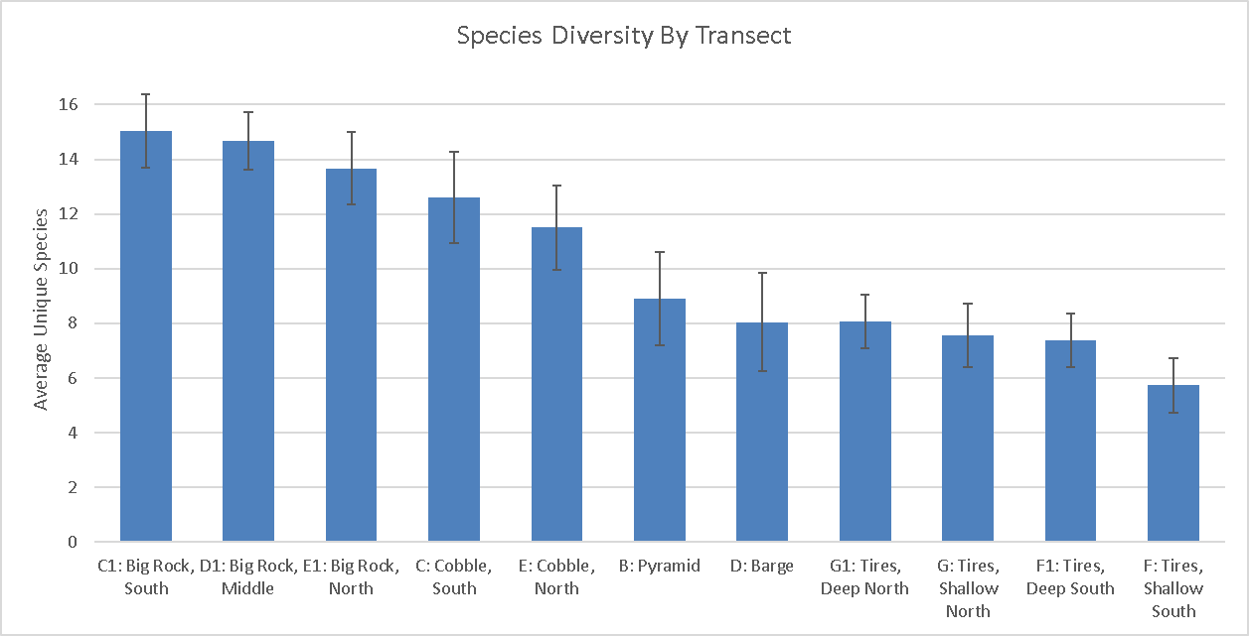
Species diversity by transect
All new reef structures: big rock / cobble located in the Marine Protected Area significantly outperformed every tire reef location in species diversity
Significant differences in sighting counts of tracked species (per survey

Slide 9
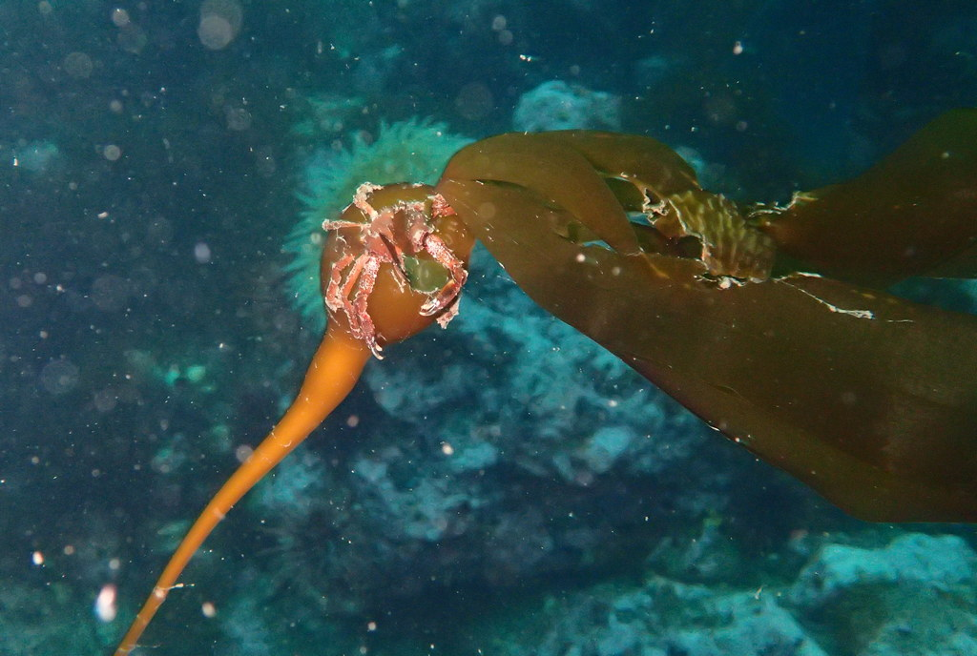
Historical location of bull kelp

Slide 10
Historical location of bull kelp

Slide 11
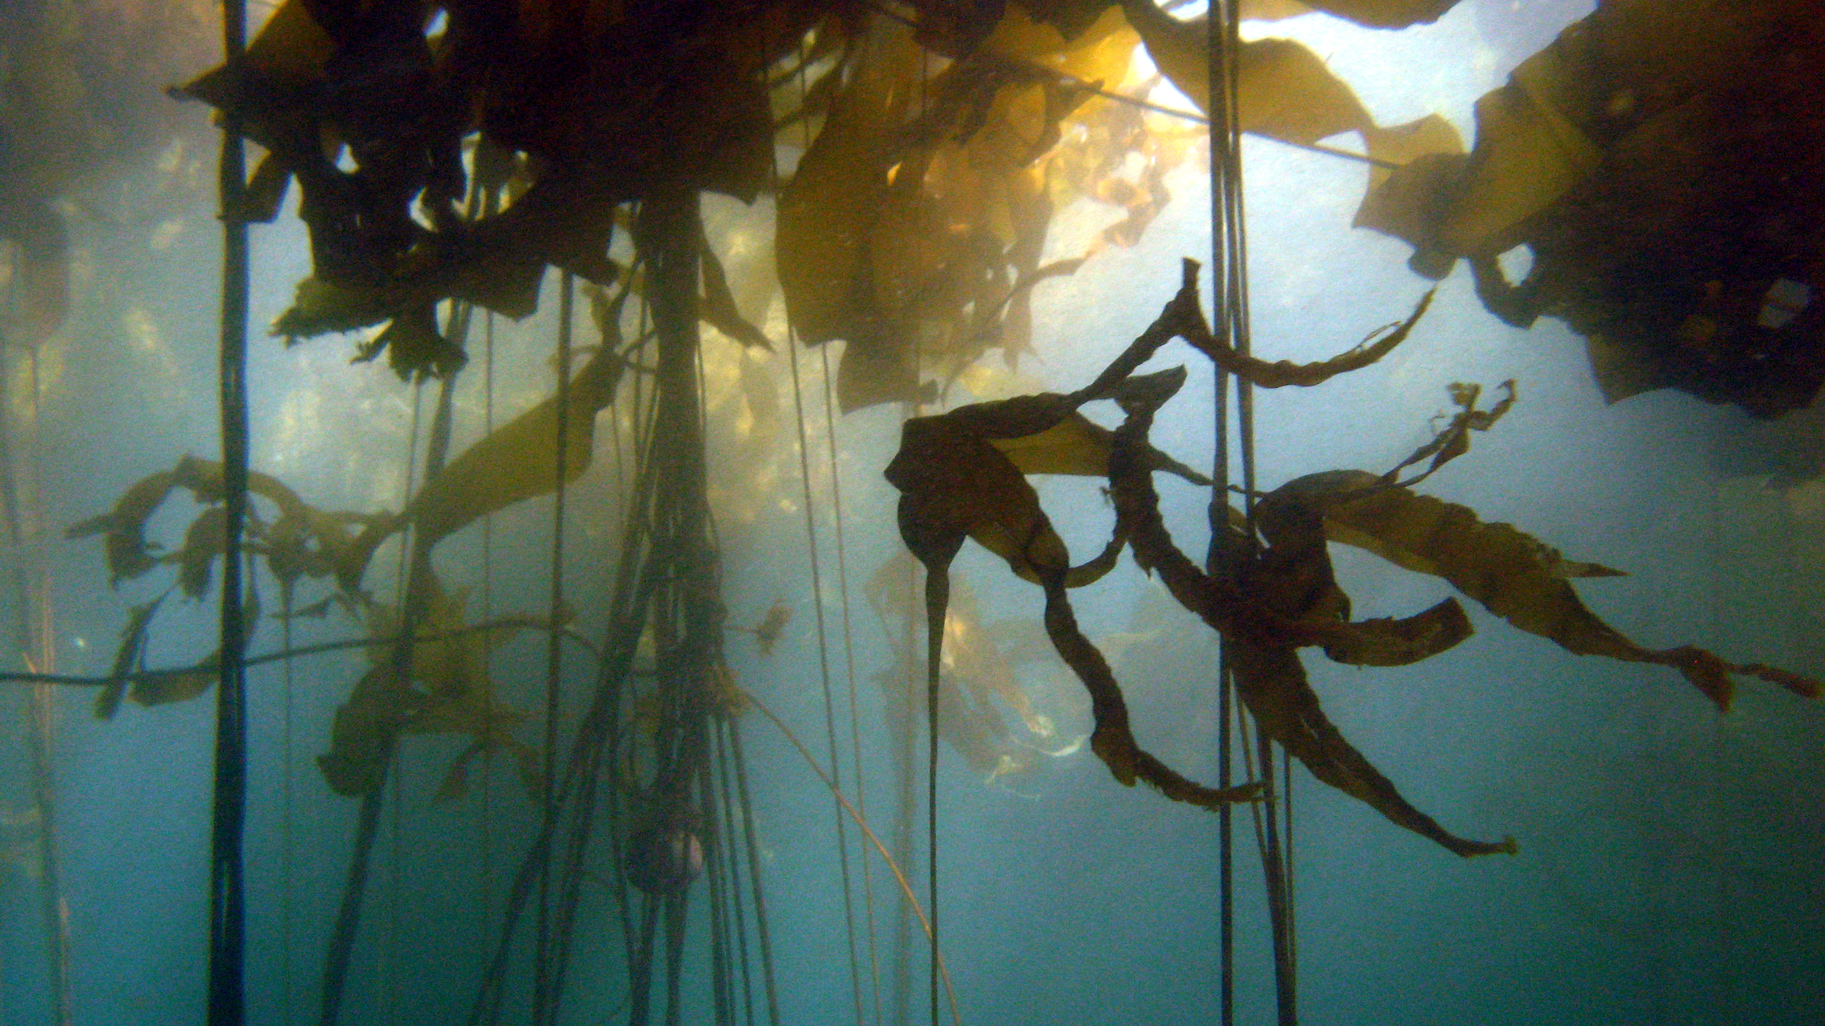
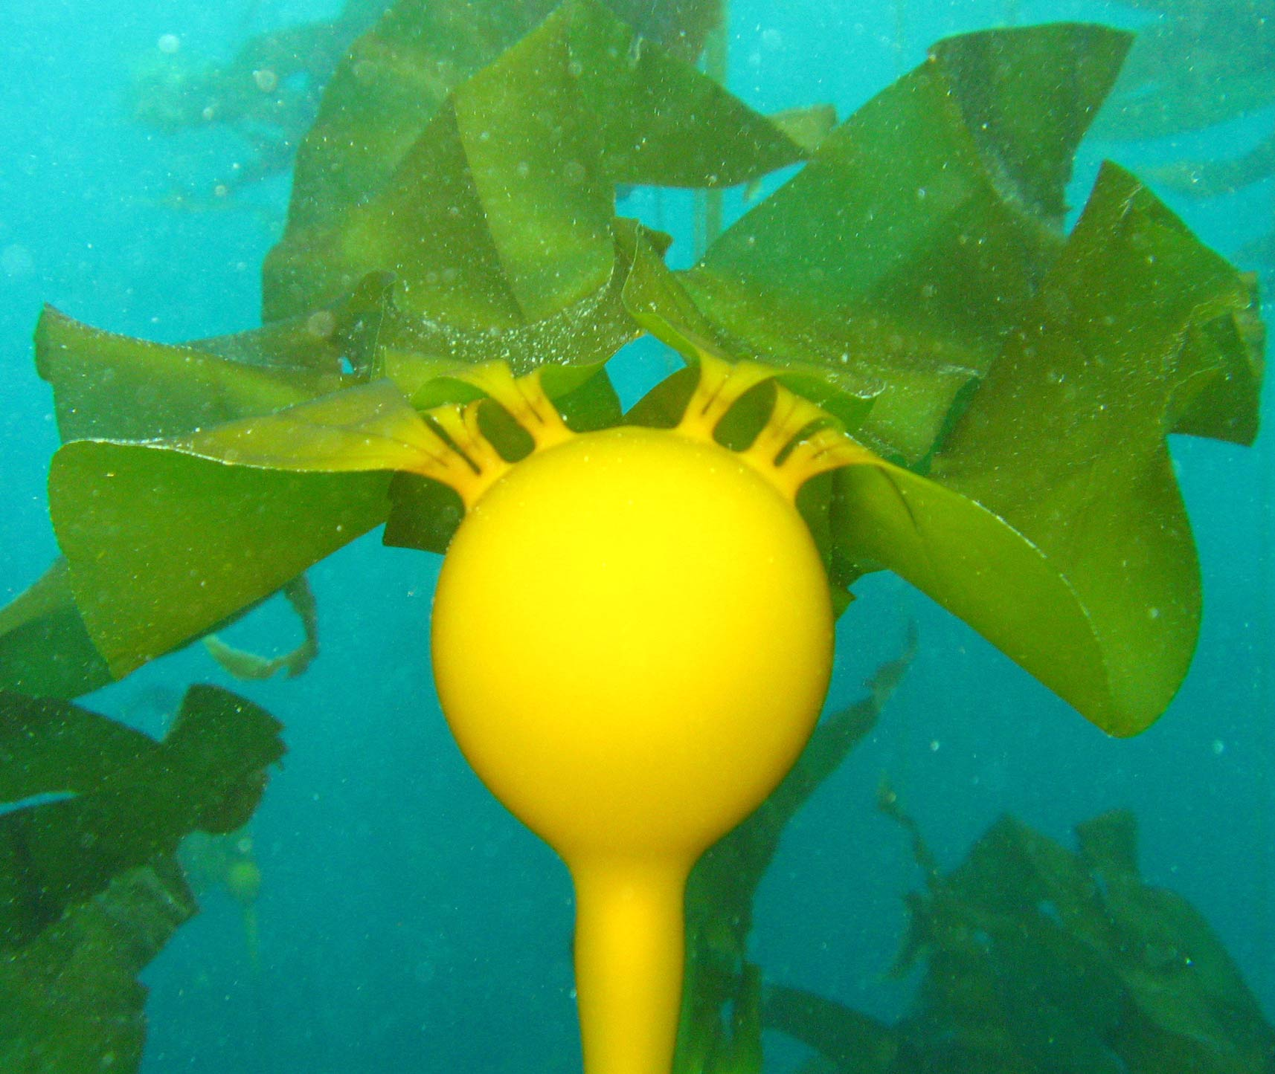
Solution: Restore bull kelp forest
Provides food and shelter for marine life
Dissipates waves
Reduces shoreline erosion
Sequesters CO2
Enhances scuba divers experience

Slide 12
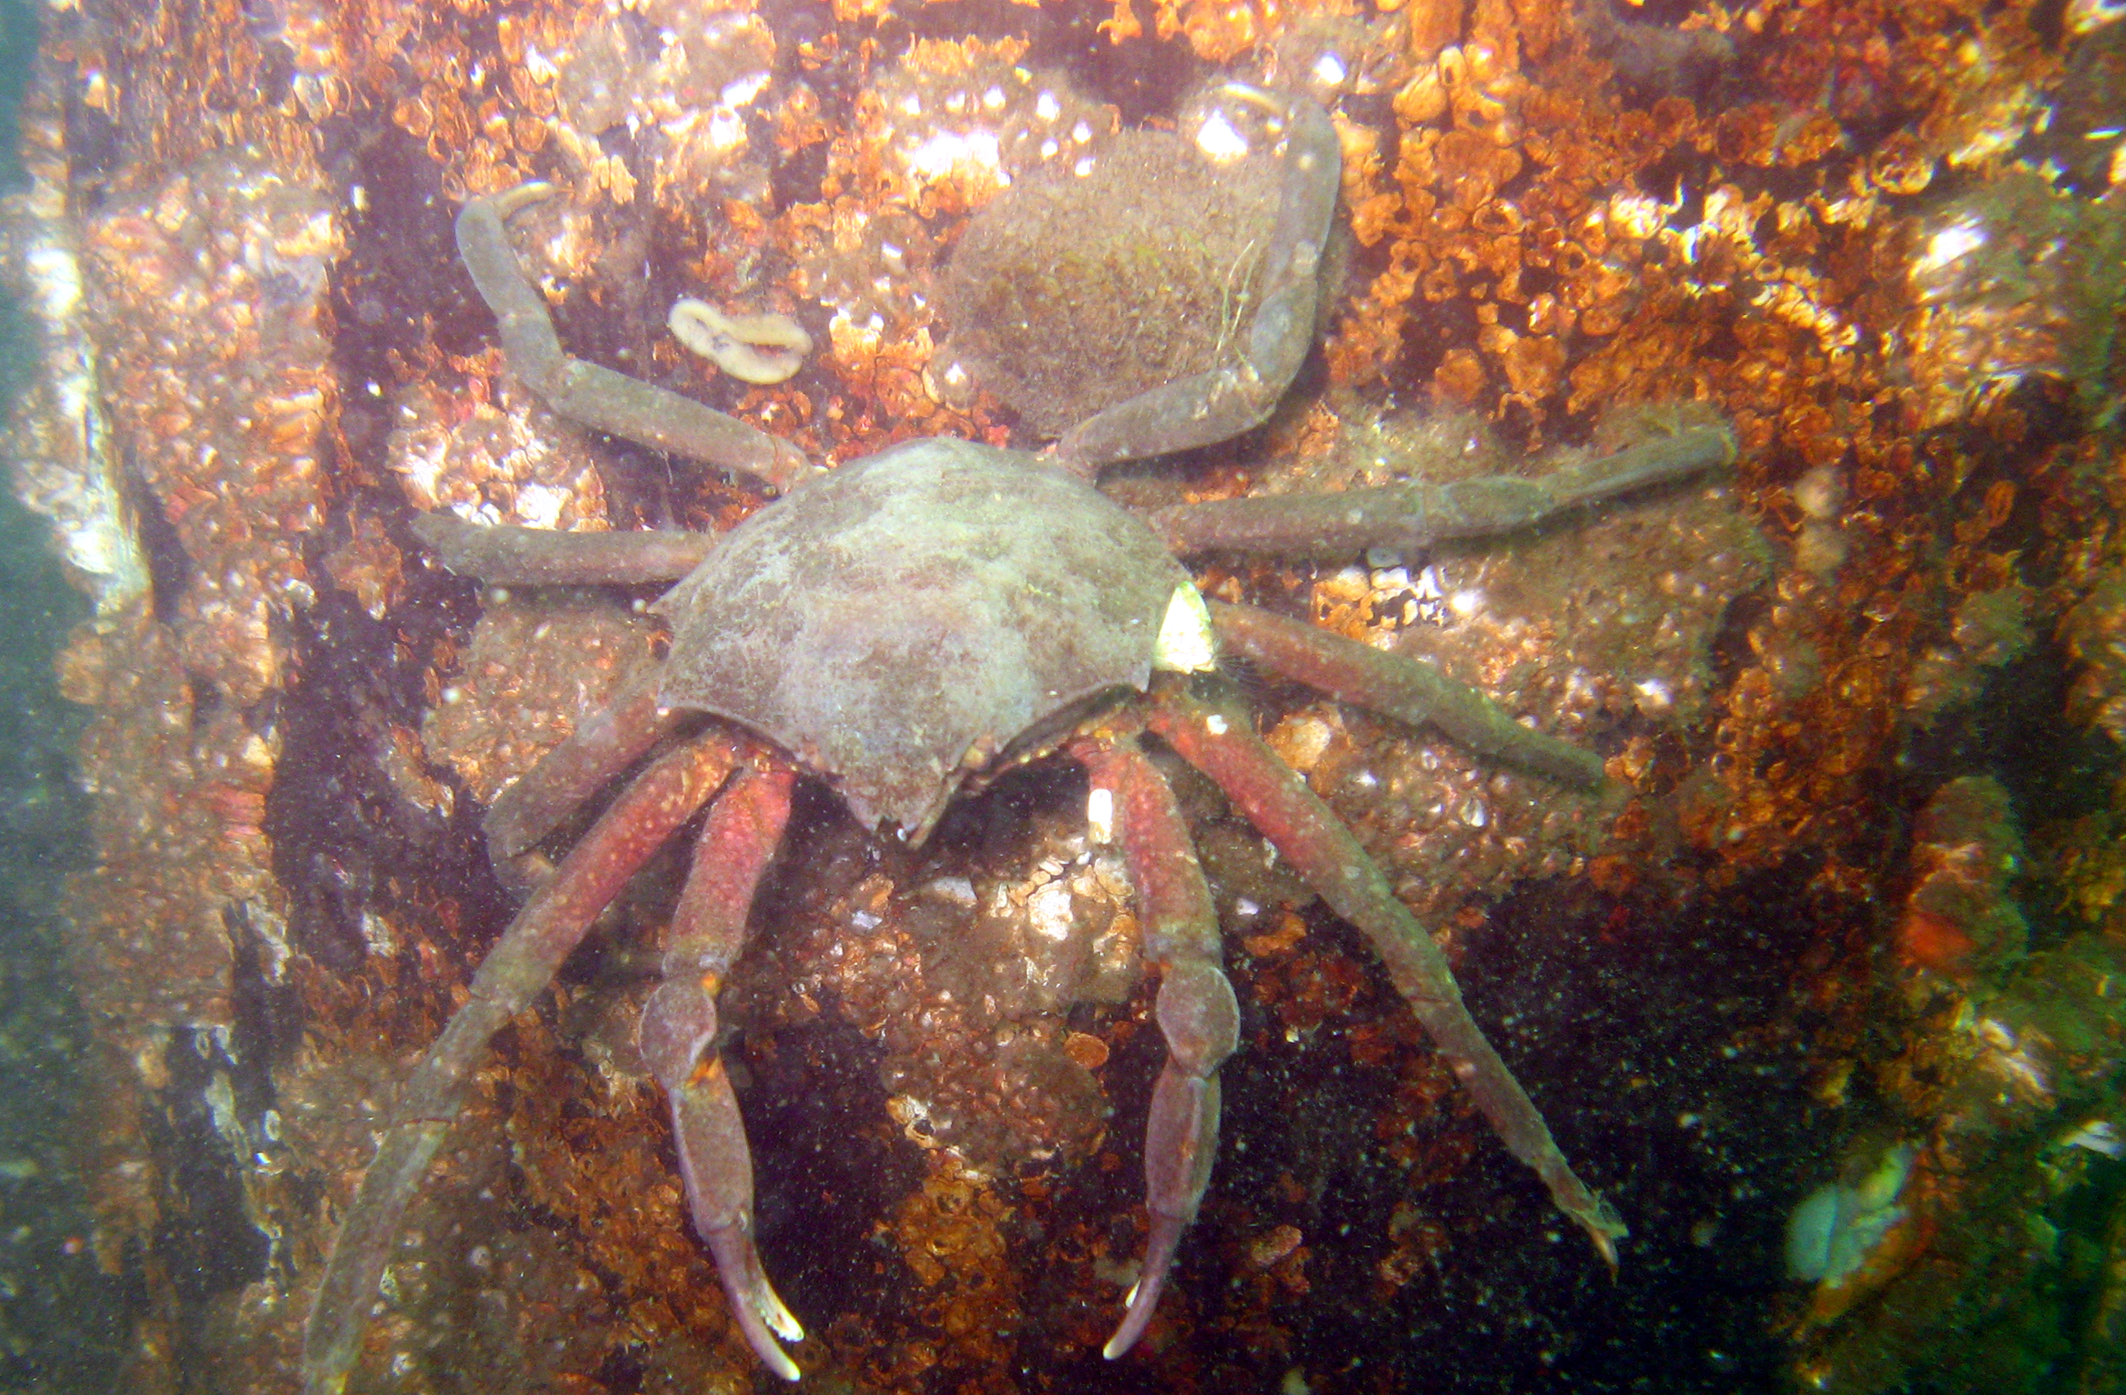
Northern kelp crab distribution
Northern kelp crabs are
primary foragers of
seaweeds.

Slide 13
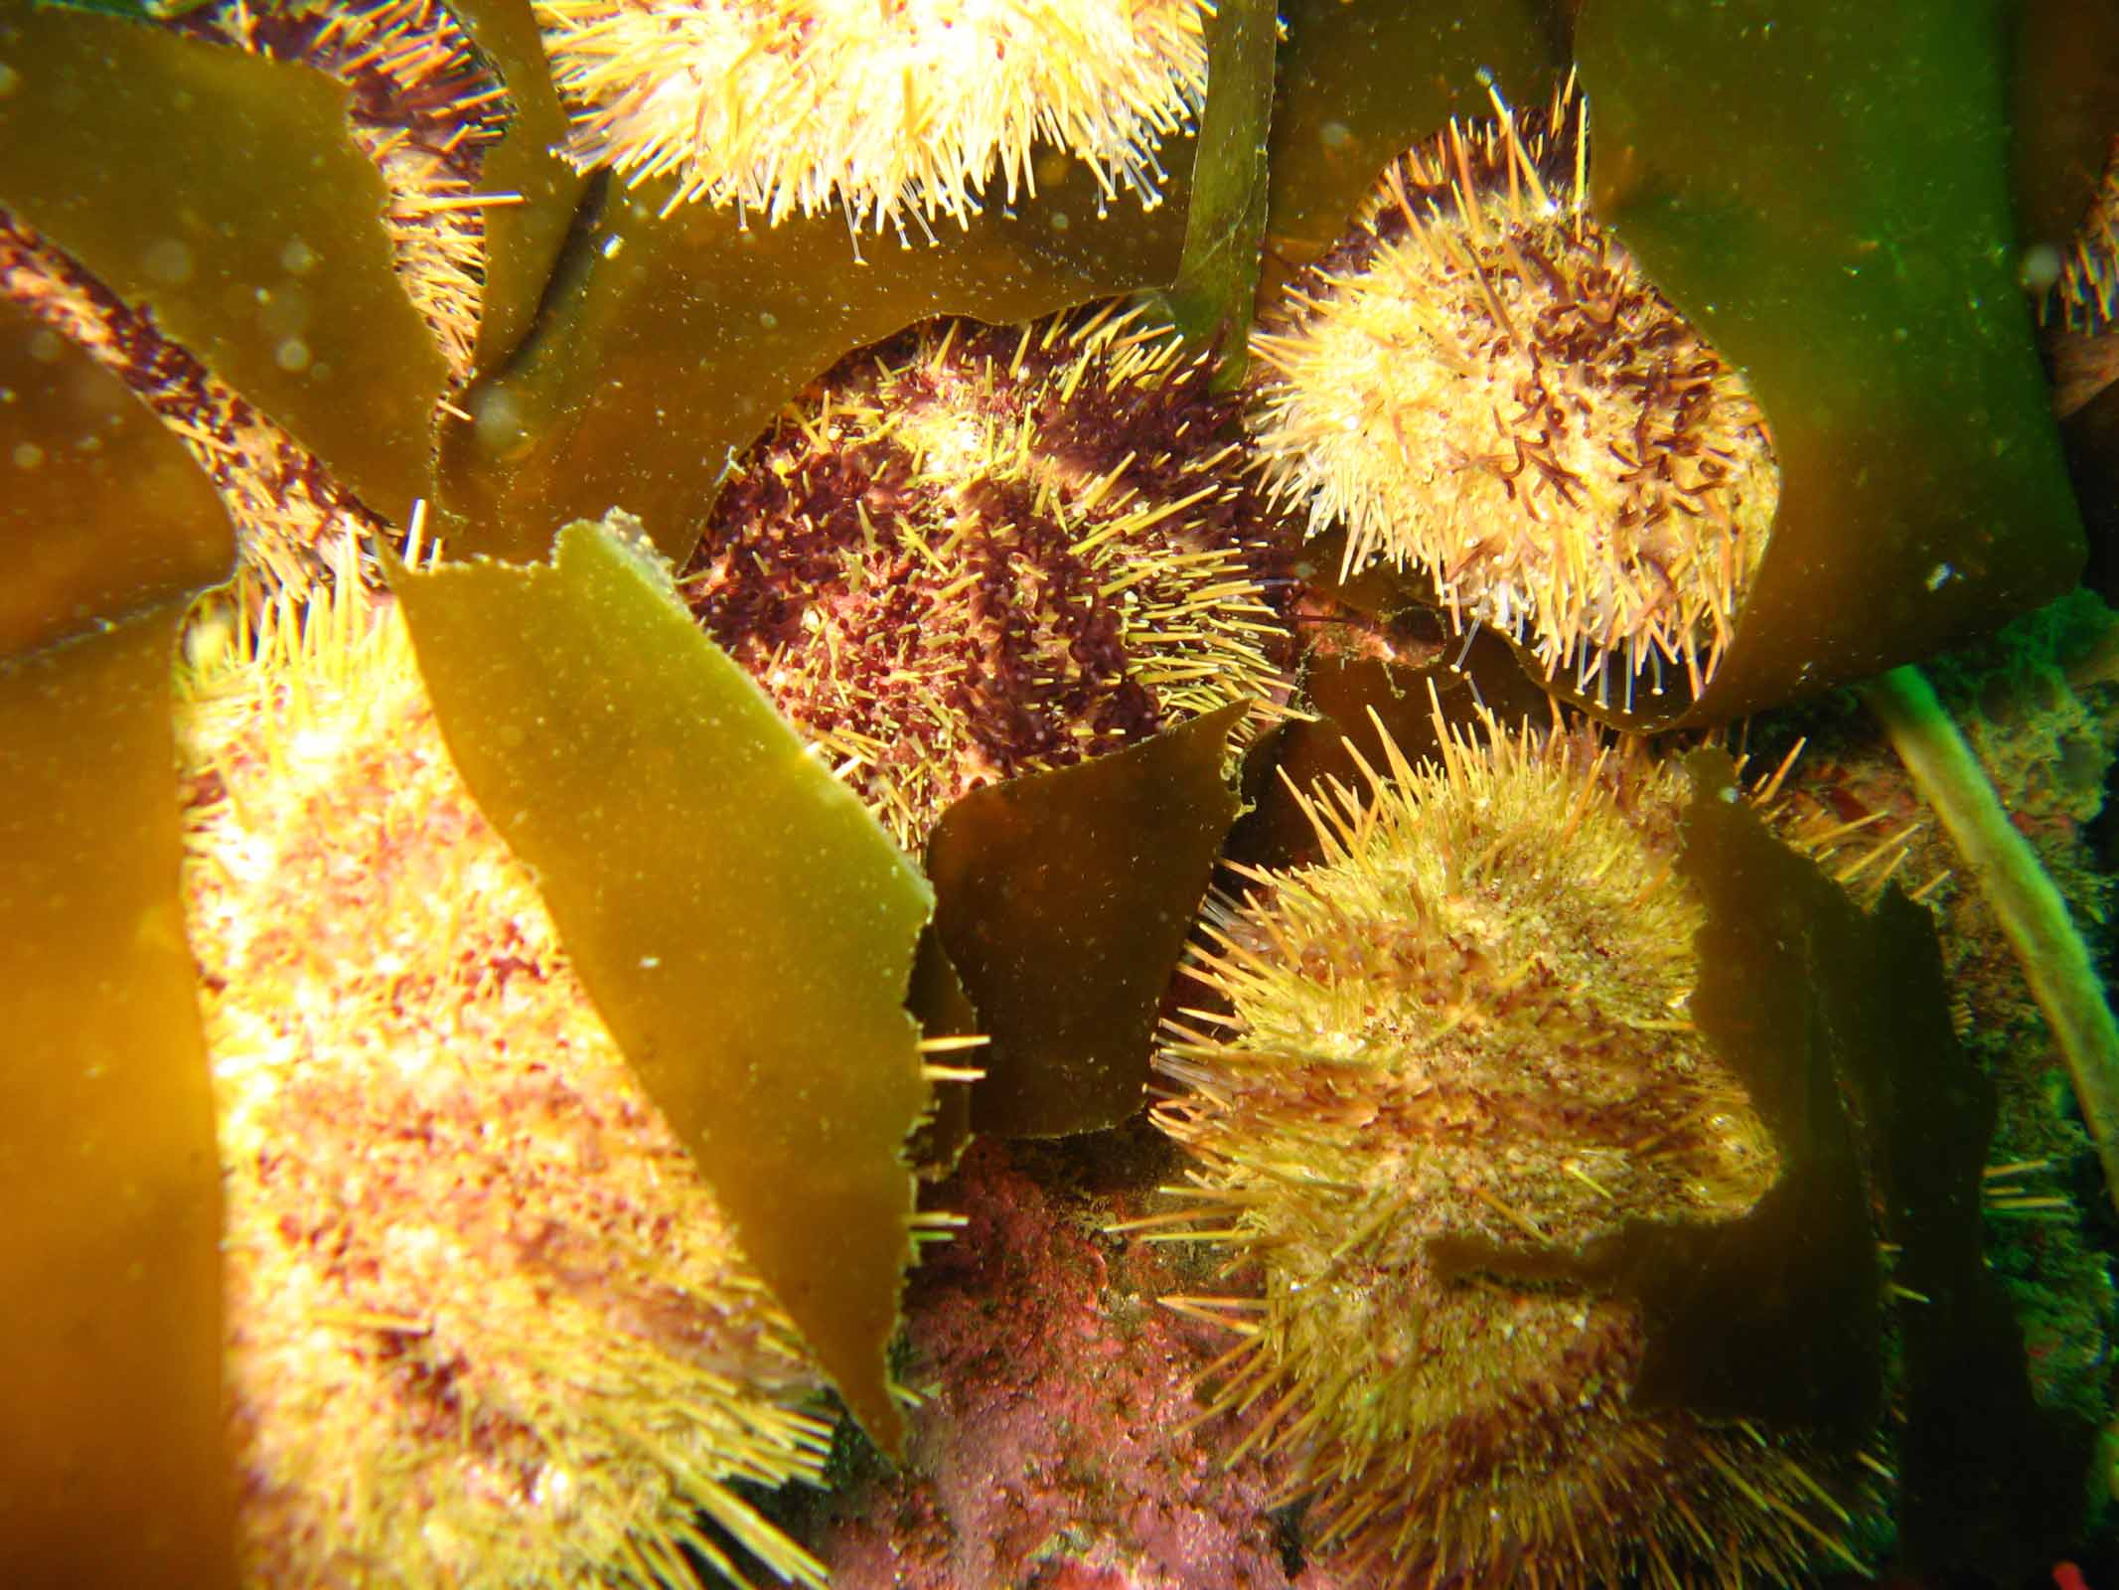
Green sea urchins
Green sea urchins are key
grazers of seaweeds. They
are not found in other areas
monitored in the park.

Slide 14
Seasonal seaweed coverage
Nereocystis, Sargassum and eelgrass are not found in these areas.
Seaweed found in boulder reefs is negligible.

Slide 15
Tire reef seasonal seaweed coverage
Nereocystis, Sargassum and eelgrass are not found in this area.

Slide 16
Seastars

Slide 17
Harvested marine invertebrates
Spot prawns
Coonstriped shrimp
Dungeness crab
Red rock crab
California sea cucumbers
Green sea urchins
Geoducks
Horse clams
Pink scallops
Rock scallops
Giant Pacific Octopus
Market squid (eggs)
-Invertebrates not found during surveys are: spot prawns, rock scallops, adult squid.

Slide 18
Harvested invertebrates seasonal averages

Slide 19
Other invertebrates monitored averages

Slide 20
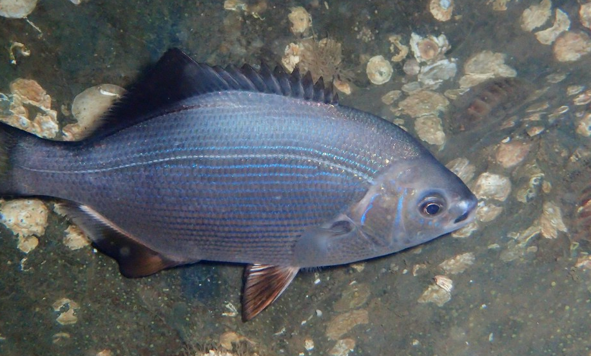
Forage fish observed in the boulder reefs
3 Boulder Reefs

Slide 21
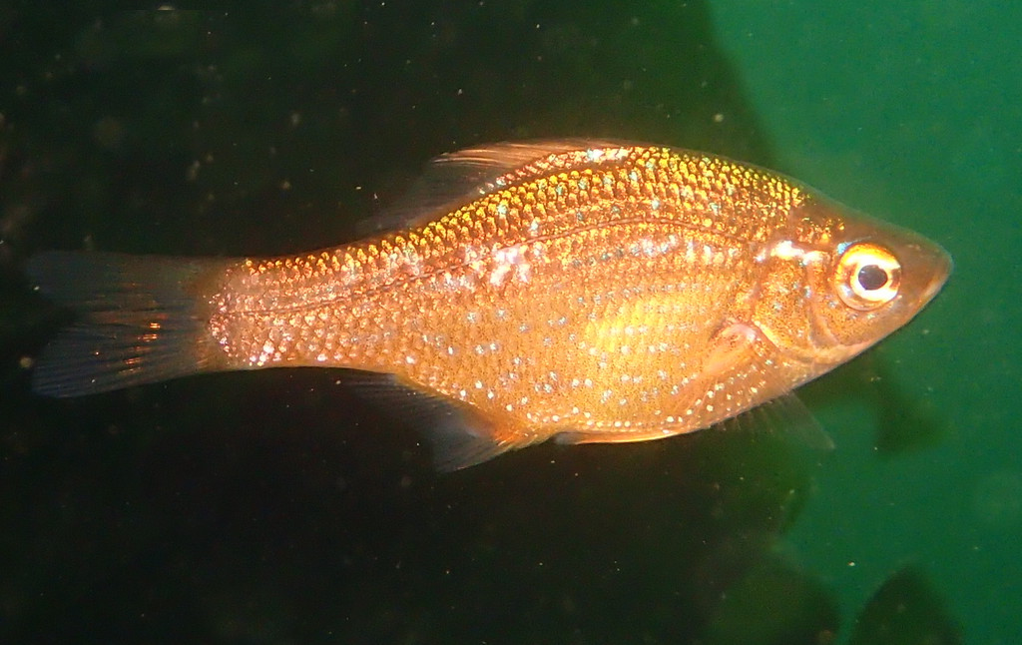
Forage fish observed in the cobble reefs
Cobble

Slide 22
Forage fish observed in the tire reefs
Tires

Slide 23
All fish observed averages

Slide 24
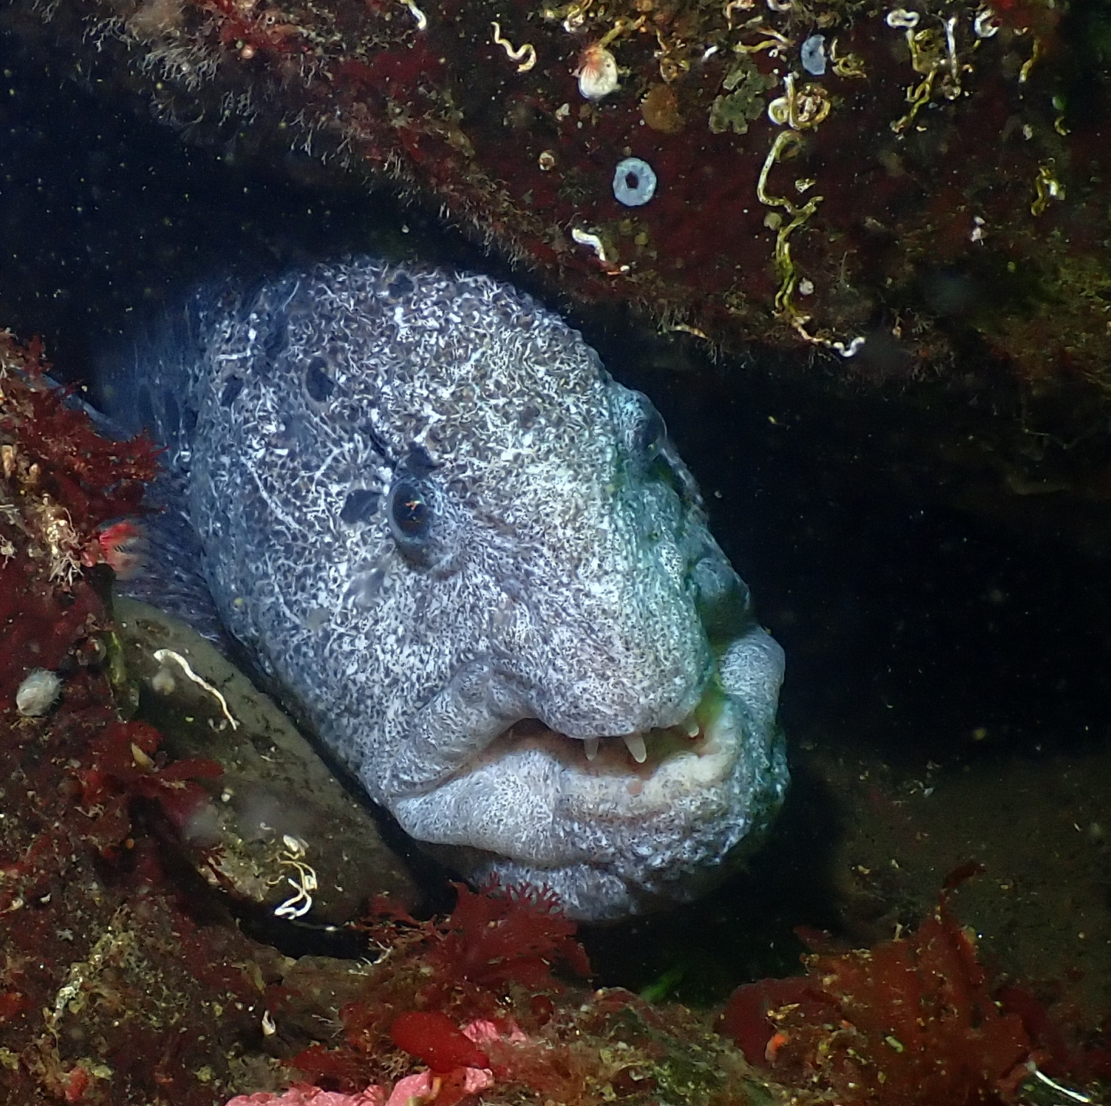
Fish least observed

Slide 25
Rockfish averages

Slide 26
Rockfish averages boulder reefs

Slide 27
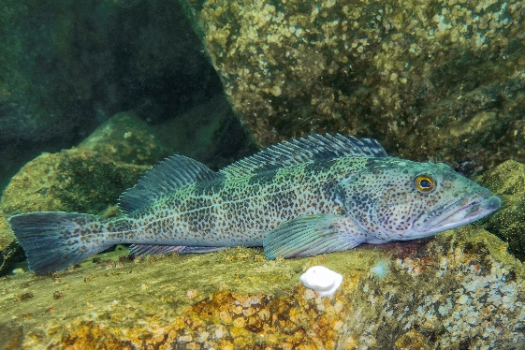
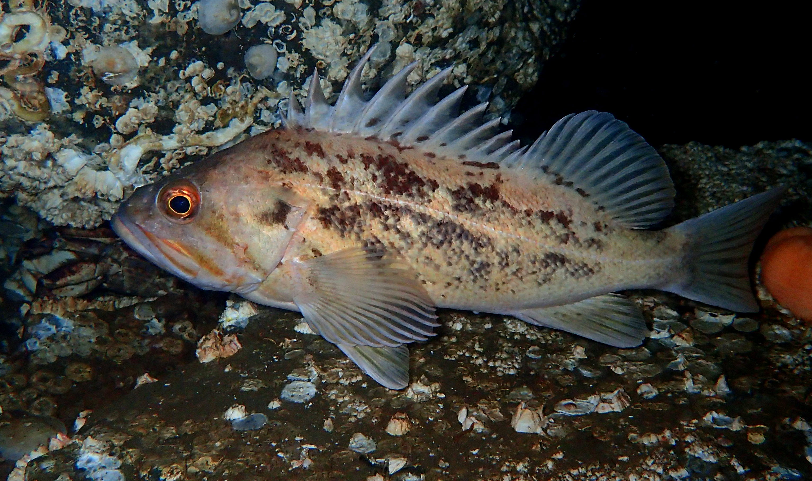
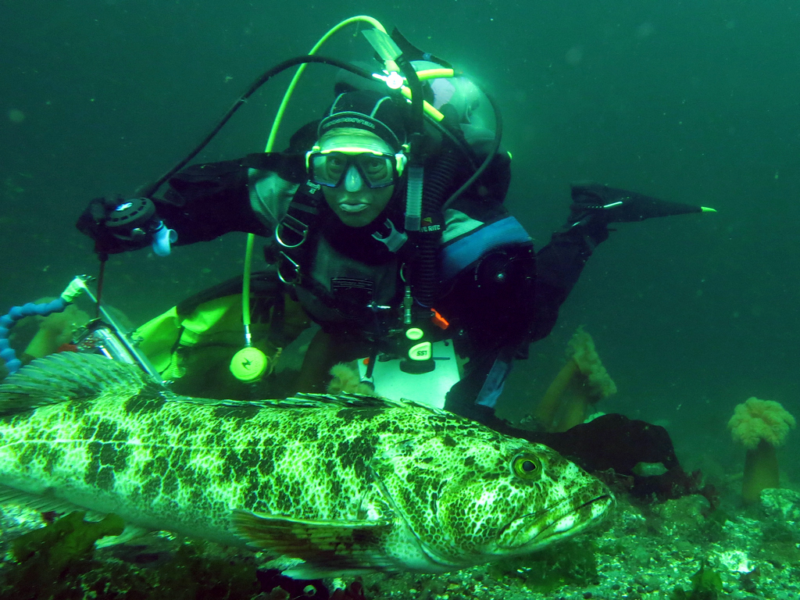
Rockfish and lingcod
Brown rockfish
Lingcod
Copper rockfish
Lingcod are a top predator and consume rockfish.

Slide 28
Thanks for your support
AAT REEF surveyors/scientific divers, divers, photographers and analysts
*Jackie DeHaven Myers * Doug Miller * Tabitha Jacobs Mangiafico *Gary Fogelquist
*Carol Cline *Donald Noviello * Joseph Mangiafico *Debrah Halley
*Gregg Cline * Ellie Place * Claude Nichols *Chanelle Cadot
*Rhoda Green *Joshua Sera * Janna Nichols *Curtis Johnson
*Ed Gullekson *Michael Snow * Perry Webster *Myra Wisotzky
*Greg Jensen *Laura Tesler * Robin Webster *Randol Williams
*Pam Jensen *David Todd *Mikiko Williams

Slide 29
Thank you
We were able to accomplish these seasonal surveys thanks to :
Port of Seattle ACE Fund grant
Bandito Boat Charters
SeaYa Boat Charters
Public Donations
Coastal Sensing & Survey
Washington Scuba Alliance
Saltwater State Park

